Slide 2
Speakers
Jose Collazo
Regional Vice President and
Business Consultant
John Hancock Investment Management
Karen Lau Gibian
Associate General Counsel of Tax Law
Investment Company Institute
Danan Kirby
Vice President and Client Portfolio
Manager
Ariel Investments
Varinia T. Siefker
Vice President and Intermediary
Relationship Manager
Dodge & Cox

Slide 3
Agenda
Introduction to ICI and the asset management industry
Career opportunities
  Investments
  Operations
  Sales
A day in the life of an employee in asset management
Questions

Slide 4
ICI and Its Mission
ICI is the leading association representing regulated funds globally, including mutual funds, exchange-traded funds (ETFs), closed-end funds, and unit investment trusts (UITs).
Mission:
Advance the interests of investment companies, their shareholders, directors, and advisers
Encourage adherence to high ethical standards by all industry participants
Promote public understanding of investment companies

Slide 5
What Are Registered Funds?
Mutual Funds
Exchange-Traded Funds
Closed-End Funds
Unit Investment Trusts

Slide 6
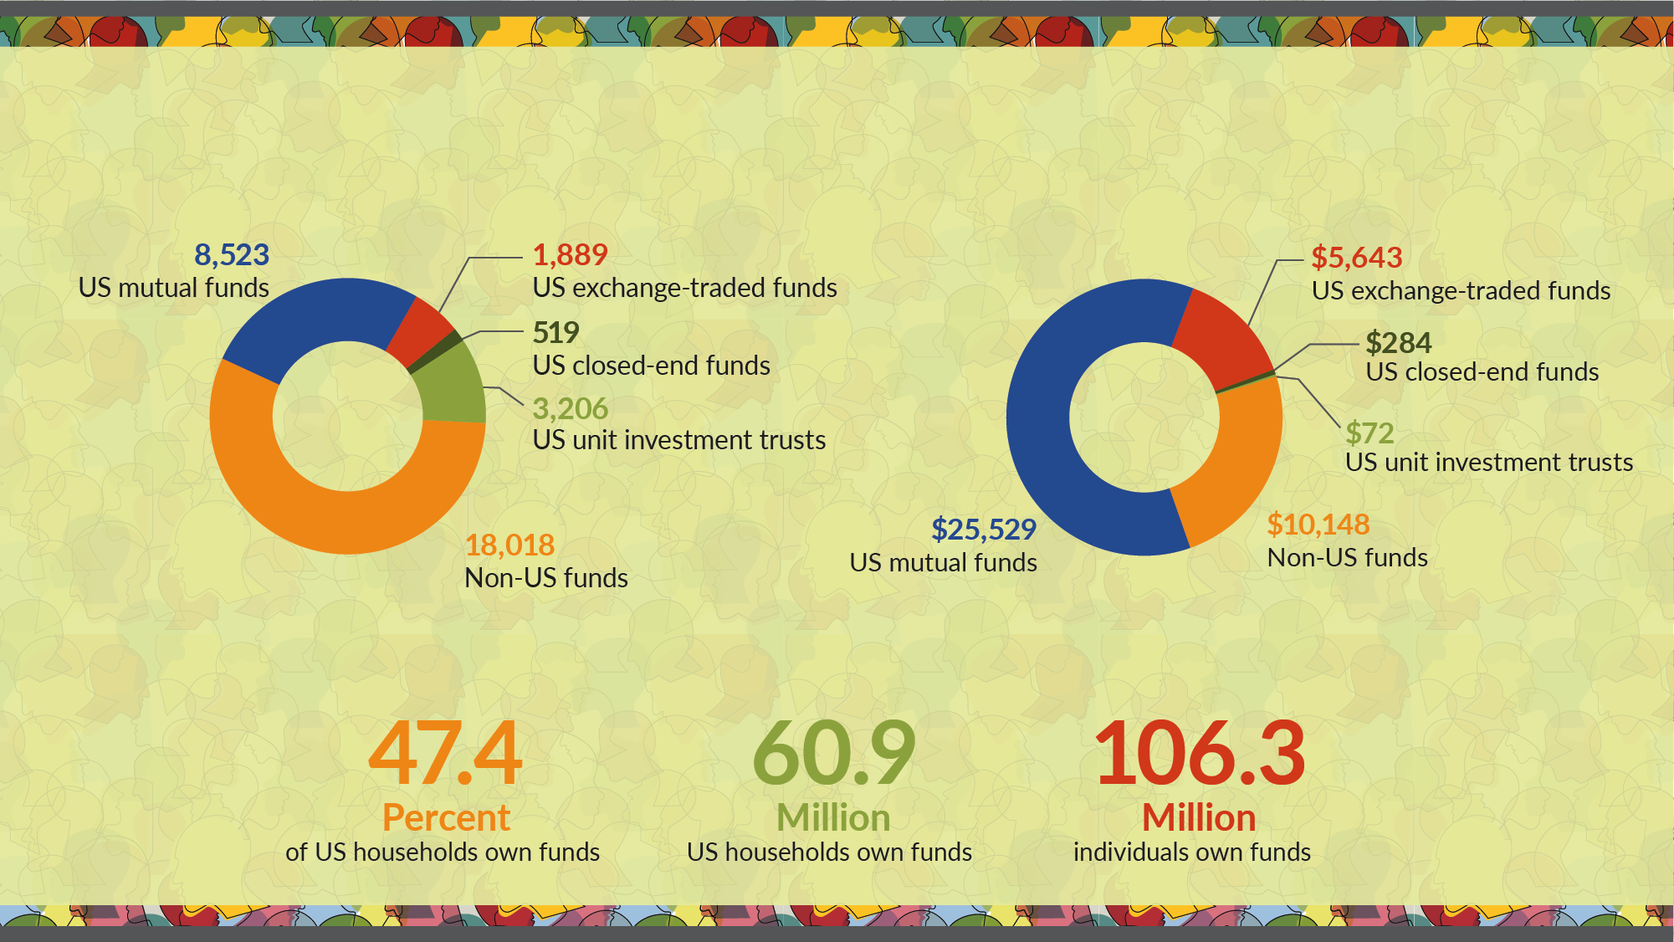
ICI Membership at a Glance
More than 32,000 funds
Number of investment companies by type*
With $41.6 trillion in assets
Investment company assets, billions of dollars*
Serving more than 100 million shareholders
US ownership of funds offered by investment companies*
* Data for US mutual funds, closed-end funds, exchange-traded funds, unit investment trusts, and non-US funds are as of June 30, 2021. Data for ownership of funds are as of mid-2020.

Slide 7
Mutual Fund Contributions to the Economy
Mutual funds have made securities markets more accessible
    Mutual funds held about 22% of publicly traded US stock in 2020. All registered investment companies held 30%.
Money market funds lower cost of financing for businesses
Fund purchases of mortgage-backed securities lower costs of home ownership
Fund purchases of state and local government securities finance projects such as roads, bridges and hospitals

Slide 8
Distribution of US Households Owning Mutual Funds by Education Level of Head of Household
Note: Head of household refers to the sole or co-decisionmaker for household saving and investing. Source: Investment Company Institute Annual Mutual Fund Shareholder Tracking Survey

Slide 9
Asset Managers
Invest client money, acting as fiduciary, for a fee
  This allows clients to obtain professionally managed and diversified portfolios at a reasonable cost
Regulated as an “Investment Adviser”
  An asset manager is different from a bank, insurance company, or broker-dealer
  While some are stand-alone asset managers, many are affiliated with other types of financial services firms
  Sound, strong regulation is critical to industry success!

Slide 10
Asset Management Clients
Individuals
Corporations and Banks
Retirement Plans and Trusts
Governments
Foundations and Endowments
Charities
Insurance Companies

Slide 11
CAREER PATHS & OPPORTUNITIES

Slide 12
A DAY IN THE LIFE

Slide 13
QUESTIONS?

Slide 14
Upload Your Resumé
Webinar participants are invited to upload their resumes to ICI’s Talent Connection Resumé Database.
ICI member firms will have access to the resumés and may contact participants directly regarding internship and job possibilities.

