Slide 2
Speakers
Erica Green
Principal and Chief Compliance Officer
Vanguard Marketing Corporation
Nhan Nguyen
Assistant General Counsel
Investment Company Institute
Rana Jewel Wright
General Counsel
Harris Associates

Slide 3
Agenda
Introduction to ICI and the asset management industry
Legal and compliance career opportunities
A day in the life as an asset management lawyer
Questions

Slide 4
ICI and Its Mission
ICI is the leading association representing regulated funds globally, including mutual funds, exchange-traded funds (ETFs), closed-end funds, and unit investment trusts (UITs).
Mission:
Advance the interests of investment companies, their shareholders, directors, and advisers
Encourage adherence to high ethical standards by all industry participants
Promote public understanding of investment companies

Slide 5
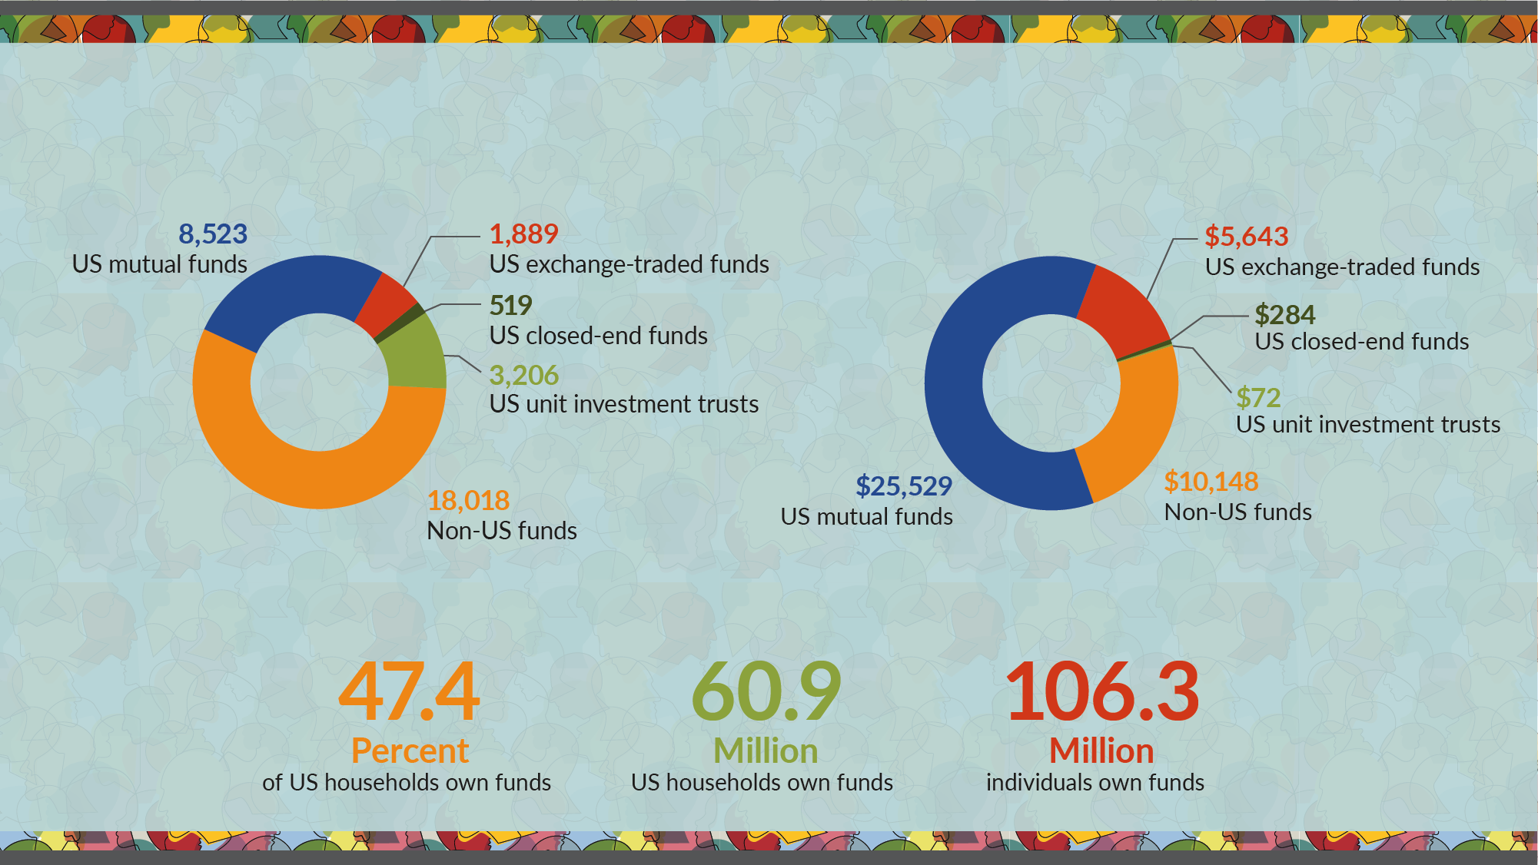
ICI Membership at a Glance
More than 32,000 funds
Number of investment companies by type*
With $41.6 trillion in assets
Investment company assets, billions of dollars*
Serving more than 100 million shareholders
US ownership of funds offered by investment companies*
* Data for US mutual funds, closed-end funds, exchange-traded funds, unit investment trusts, and non-US funds are as of June 30, 2021. Data for ownership of funds are as of mid-2020.

Slide 6
Asset Management 101
What is the asset management industry?
Who (or what) are asset managers?
Who (or what) are their clients?

Slide 7
Asset Managers
Invest client money, acting as fiduciary, for a fee
  This allows clients to obtain professionally managed and diversified portfolios at a reasonable cost
Regulated as an “Investment Adviser”
  An asset manager is different from a bank, insurance company, or broker-dealer
  While some are stand-alone asset managers, many are affiliated with other types of financial services firms
Use a variety of vehicles to serve clients
    Mutual Funds
    ETFs
Hedge Funds
  Separately Managed Accounts
Common Trusts

Slide 8
Mutual Fund Regulations
Subject to four major federal securities laws
    Securities Act of 1933
    Securities Exchange Act of 1934
    Investment Advisers Act of 1940
    Investment Company Act of 1940
Sound, strong regulation is critical to industry success

Slide 9
Asset Management Clients
Individuals
Corporations and Banks
Retirement Plans and Trusts
Governments
Foundations and Endowments
Charities
Insurance Companies

Slide 10
Legal Careers in Asset Management
asset managers Require support from Many Types of Lawyers and Compliance Professionals
Regulatory Specialists
  Investment Company Act
  Investment Advisers Act
  ERISA
  International Regulation
Legal Generalists
  Litigators
  Commercial/Contractual
  Corporate Governance/Securities
  Intellectual Property
  Employment/Employee Benefits
  Data Privacy
Compliance Professionals
  Investments
  Trading
  Advertising/Client Communications
  Licensing/Regulatory Filings
  Ethics/Training
Investments
Trading
Legal
&
Compliance
Corporate
Distribution
IT/Cyber Security
Operations/Support

Slide 11
Where do Asset Management Lawyers Work?
As in-house counsel, at asset management firms, corporations, or other businesses with significant investment portfolios
At a company that helps to support asset managers, like consulting firms, accounting or auditing firms, or other vendors
At law firms, as outside counsel
In government, at federal regulators like the Securities & Exchange Commission (SEC) or similar state regulators
In policy circles, at trade associations, think tanks, or similar advocacy organizations
In academia, at law schools or undergraduate institutions

Slide 12
QUESTIONS?

Slide 13
Upload Your Resume
Webinar registrants are invited to upload their resumes to ICI’s Talent Connection Resumé Database.
ICI member firms will have access to the resumés and may contact participants directly regarding internship and job possibilities.

Slide 14


